Slide 1
Modelling full 3D velocity, pressure, and temperature fields of two flow scenarios

Slide 2
Full NSE equations with temperature if applicable
Two flow scenarios explored:
Oscillating pressure gradient in isothermal fluid
dP/dz = exp(iwt)
Constant pressure gradient pipe flow with constant heat flux
q’’(R) = const
Equations implemented in cylindrical coordinates
4 independent variables (t; r, phi, z)
4 (5 with Temp) dependent variables (vr, vphi, vz, P, T)
Temperature dissipation function assumed to be negligible

Slide 3
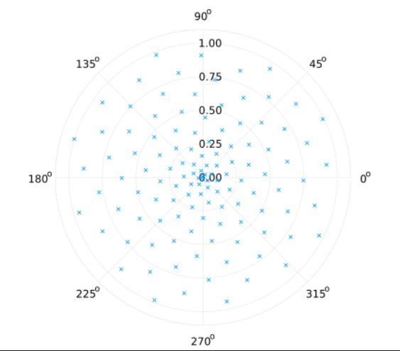
Training data
Analytical solutions exist for both cases. Used as training data at 200 points in 3D space, 10 points in time
Sampling points spread out as a Fibonacci spiral to efficiently generate evenly spaced sampling points. Placed at a unique, random longitudinal position

Slide 4
Neural Network construction
Input layer and with single output, One hidden layer with 60 nodes
One network per dependent variable (how NeuralPDE.jl handles systems of PDEs)
Activation function is tanh_fast (Slightly less accurate tanh with 10x speedup for single precision)

Slide 5
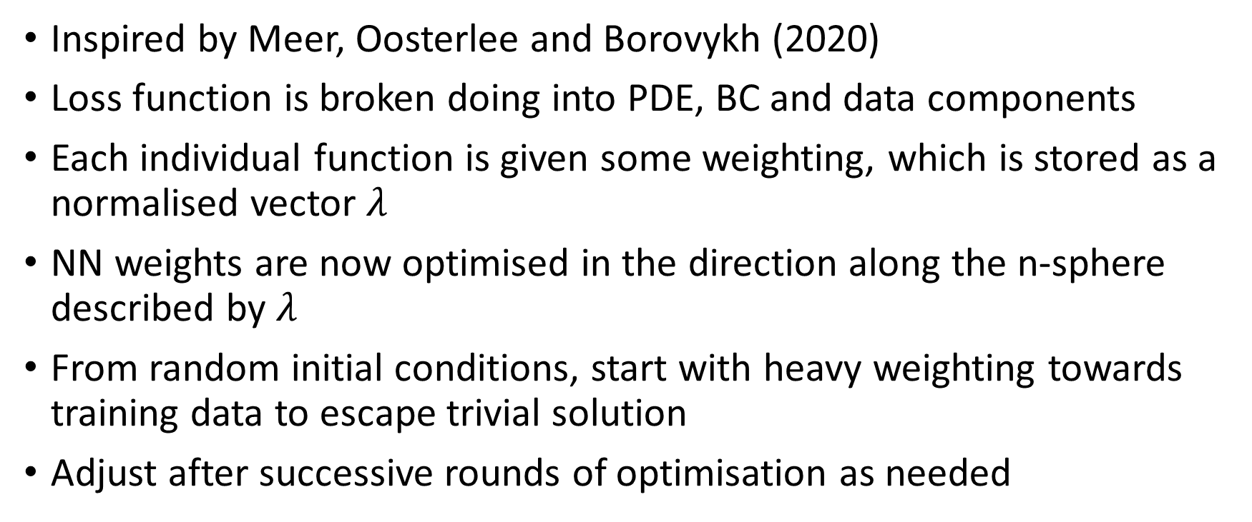
Loss function adjusting
Inspired by Meer, Oosterlee and Borovykh (2020)
Loss function is broken doing into PDE, BC and data components
Each individual function is given some weighting, which is stored as a normalised vector $λ$
NN weights are now optimised in the direction along the n-sphere described by $λ$
From random initial conditions, start with heavy weighting towards training data to escape trivial solution
Adjust after successive rounds of optimisation as needed

Slide 6
Optimisation (Oscillating pressure)
Began with ADAM at rates of [1e-2,1e-3], ran for 2500 iterations each (5000 total)
Afterwards, L-BFGS was used exclusively for 5000 iterations
Final loss value was ~ 4.84e-5, dominated by the data

Slide 7
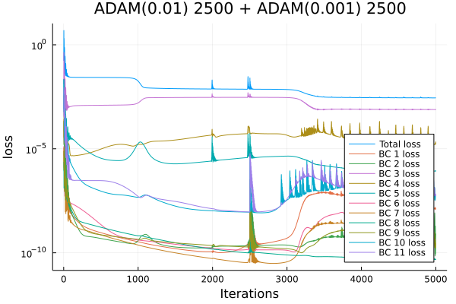
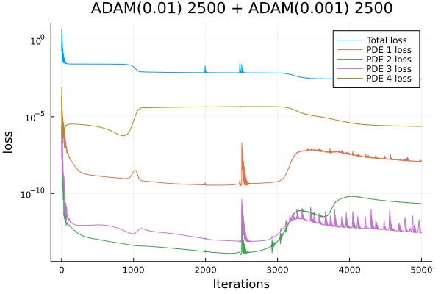
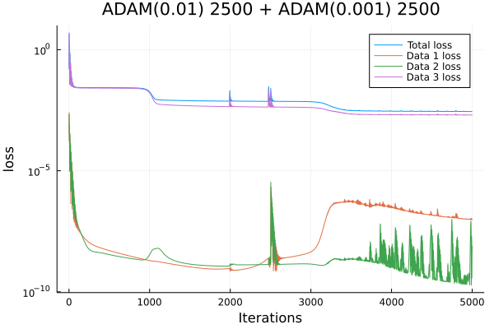
Learning curves

Slide 8
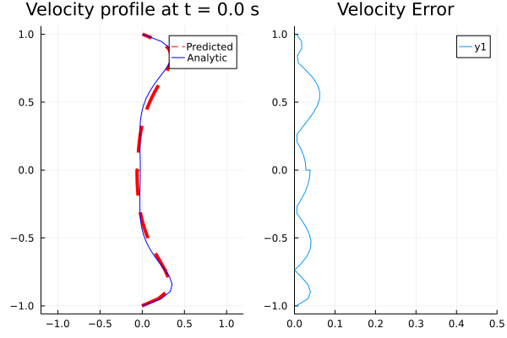
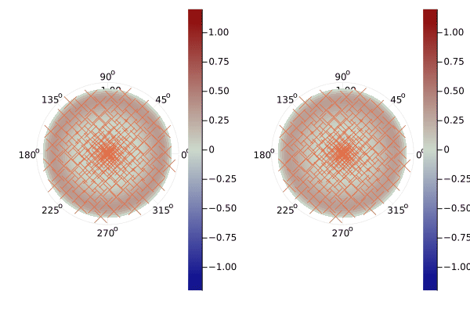
Results

Slide 9
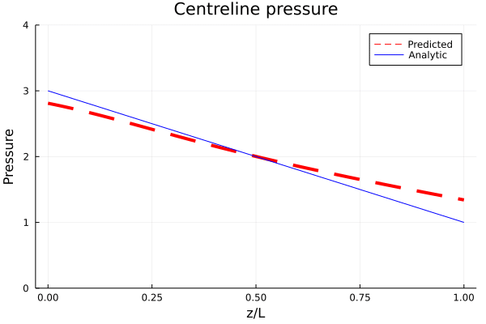
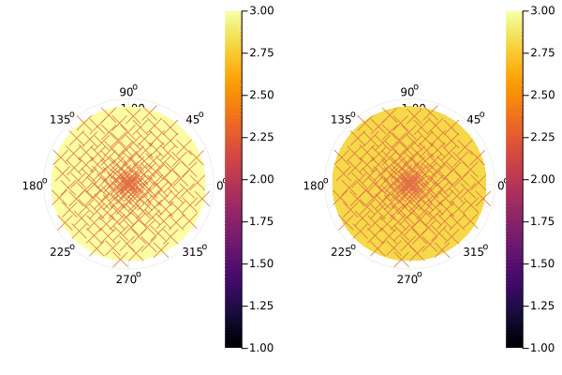
Pressure prediction still lacking

Slide 10
Further training
Biased towards z momentum PDE and data (weighted at 10000 each)
Rest of the loss functions weighted at 1
2000 iterations L-BFGS

Slide 11
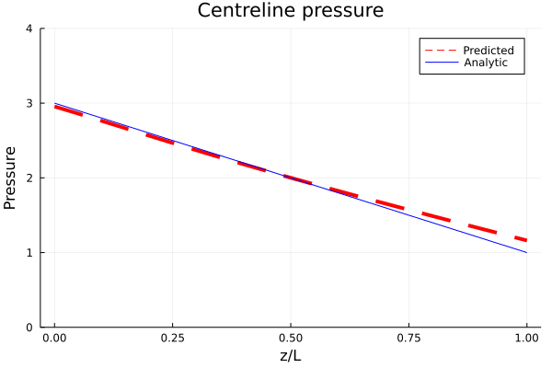
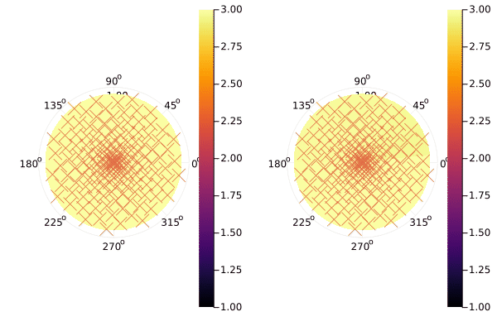
Results
Pressure closer but nowhere near accuracy of 2D and 1D cases

Slide 12
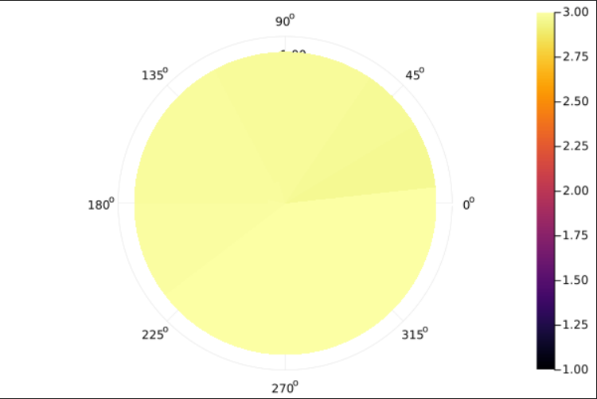
Slight asymmetry in Pressure (~1% error)

Slide 13
Optimisation (Temperature)
ADAM at decreasing rates for an increasing no. of iterations
Very large loss values at ~400
Solution has yet to converge

Slide 14
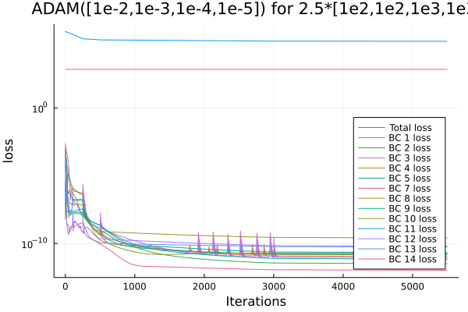
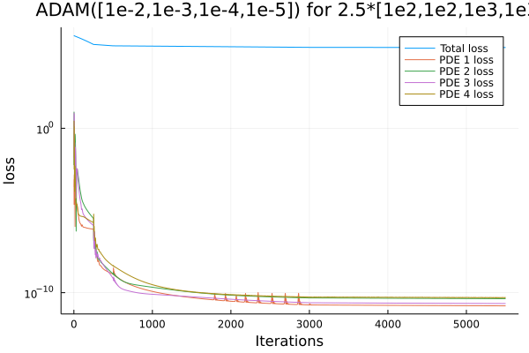
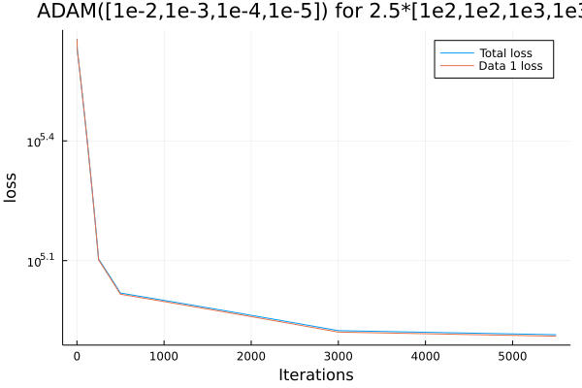
Learning curves

Slide 15
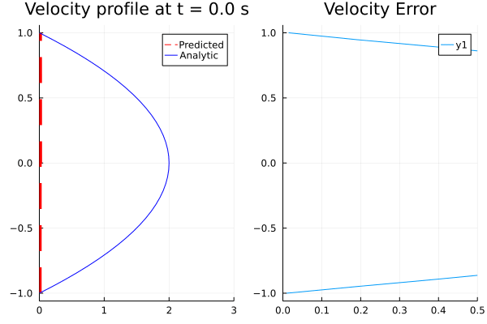
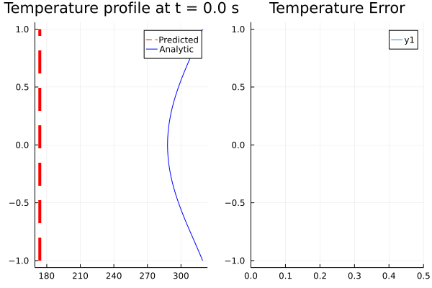
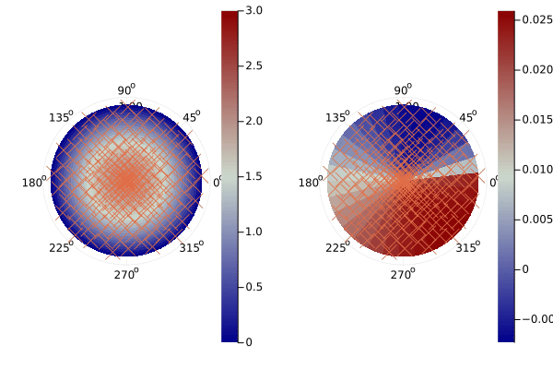
Results

